Slide 1

Predicting Points Scored in NBA Games Using Player Statistics
Intro to Machine Learning
July 30, 2024
Jennifer Gonzalez, Gayathree Gopi,
Ronak Goyal, Maria Lasala
Notes:
Introduce ourselves in the order on this title slide

Slide 2
Introduction
Problem statement:
Coaches and managers face challenges in optimizing team rosters and require precise performance predictions for the upcoming season to make informed decisions on player trades and retention
Goal:
Develop a machine learning model for sports analytics to predict a player's future performance based on their past performance data
Notes:
Maru
We chose the datasets "NBA Player Stats for the 2023-24 Regular Season" and "NBA Player Stats for the 2022-23 Regular Season". The goal is to predict the number of points per game (PTS) a player will have in future seasons, based on their past game performance (ex. minutes played, position, field-goal percentage, etc.).
This analysis will be useful for coaching and management of teams that are looking to trade players during the draft, as they can identify what kinds of players will score the most points for their team, thus be more valuable, based on different stats from their season.

Slide 3
Integration
Datasets:
Used two NBA Player Stats datasets from Kaggle
Season Identification:
Added an extra column in each file indicating the season (22-23 or 23-24) using Excel
Combination:
Merged all .csv files into a single dataset (nba.csv) with 30 columns and 6201 rows
Notes:
Maru
Wrangling done in Python: Integration of the data
Downloaded two separate datasets from Kaggle: one containing 22-23 season stats across 11 .csv files and the other containing 23-24 season stats in a single .csv file.
Used Excel to add an extra column in each file indicating the season (22-23 or 23-24) to differentiate data
Used Python code to combine all .csv files into a single dataset ‘nba.csv’ housing a total of 30 columns and 6201 rows (excluding header row).
The final dataset: every row is a player, and every column shows a different basketball metric

Slide 4
Cleaning
TOT Entries:
Masked the original dataset with a subset containing only ‘TOT’ entries to flag players who played for multiple teams in a season
Position Filtering:
Filtered the dataset to include only rows where the 'Pos' column value is one of the top 5 positions (SG, SF, PF, C, PG)
Handling Null Values:
Encountered null values in percentage columns (FG%, 3P%, 2P%, eFG%, and FT%)
Notes:
Maru
Wrangling done in Python: Cleaning of the data
Merged the original data (‘nba.csv’) with a subset containing only ‘TOT’ (total) entries to flag players who played for multiple teams in a season
Ex. during the 22-23 season, Malik Beasley played for both the Utah Jazz and the Los Angeles Lakers, so we only kept the total cumulative stats he had for that season
(helps ensure that cumulative stats for such players were accurately represented while avoiding duplication
Filtered the dataset to include only rows where the ‘Pos’ column value is one of the top 5 positions (SG, SF, PF, C, PG) to focus on the most relevant positions
Ex. other positions were like SG-PG (both shooting & point guard), which is the same thing hence we dropped these.
Encountered null values in percentage columns (‘FG%’, ‘3P%’, ‘2P%’, ‘eFG%’, and ‘FT%’)
Ex. it’s impossible for a player to score a 3 pointer if they did not attempt one, so their 3P% would be null
decided to keep these values as null and impute them during modeling, rather than set them to 0 or the median out of concern of misrepresentation and bias
If reqd, the models can take care of the null values themselves, hence kept for now, will be taken into consideration during modelling.

Slide 5
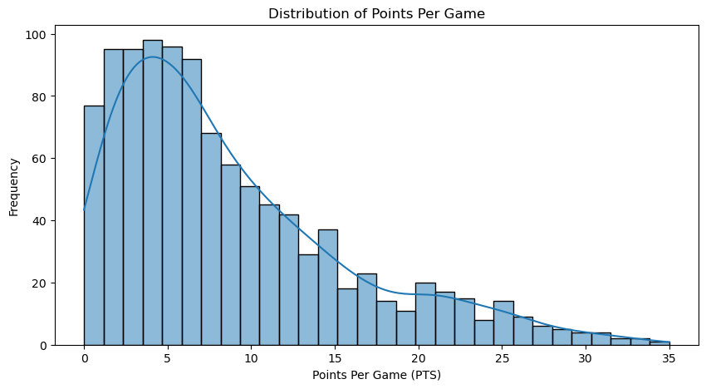
EDA
Notes:
Jenny
Plot showing frequency of PTS
histogram shows a right-skewed distribution, indicating that the majority of players score relatively few points per game, with fewer players achieving higher points
the wide range extending to higher PTS values, highlights the presence of a few high-scoring players who significantly impact the game ("star players").

Slide 6
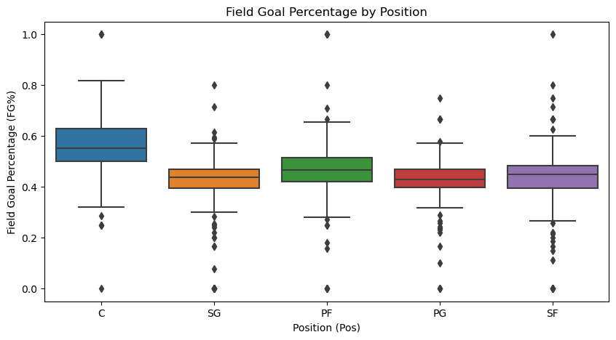
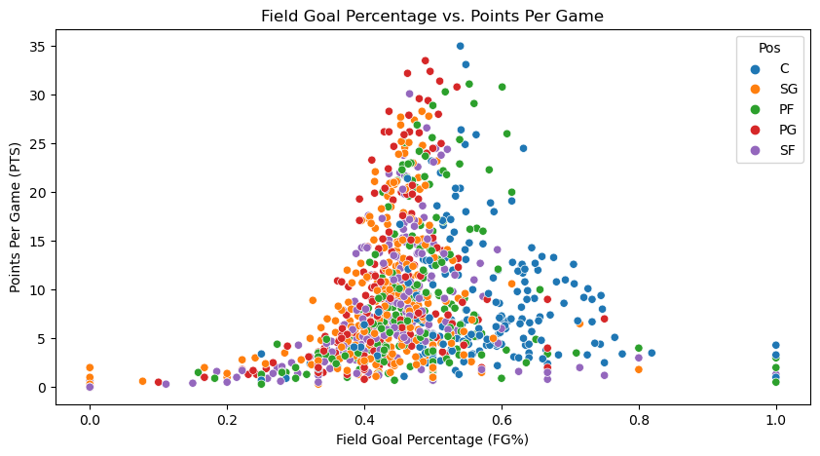
EDA
Notes:
Jenny
Plot showing FG% vs. PTS by Pos
plot illustrates that while there is a somewhat positive correlation between FG% and points per game, this relationship varies significantly across different positions
centers tend to be more efficient, with many achieving higher FG% (often above 0.6), yet they generally score fewer points per game; this makes sense because although they have a lower scoring volume, they prioritize consistency in the shots they do take
guards, particularly shooting guards, and small forwards, tend to score higher points per game even with moderate FG% (around 0.4 to 0.5); that makes sense as these positions usually take more perimeter shots, which generally have lower percentages

Slide 7
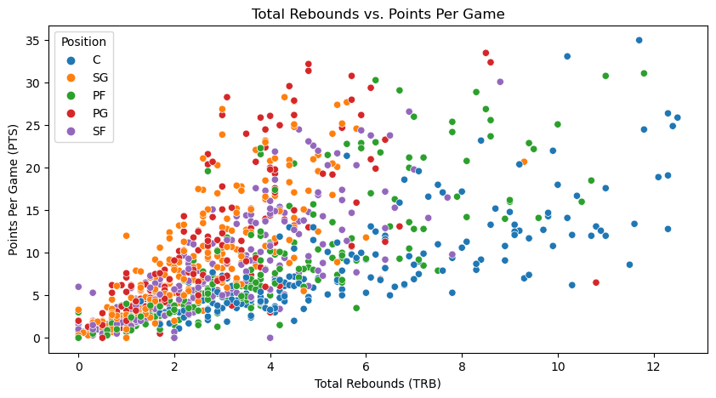
EDA
Notes:
Jenny
Plot showing TRB vs. PTS
One more observation: there is a slight positive correlation between TRB & PTS, suggesting that players who are active in rebounding (specifically offensive) can also contribute to scoring, particularly for positions like power-forwards and centers

Slide 8
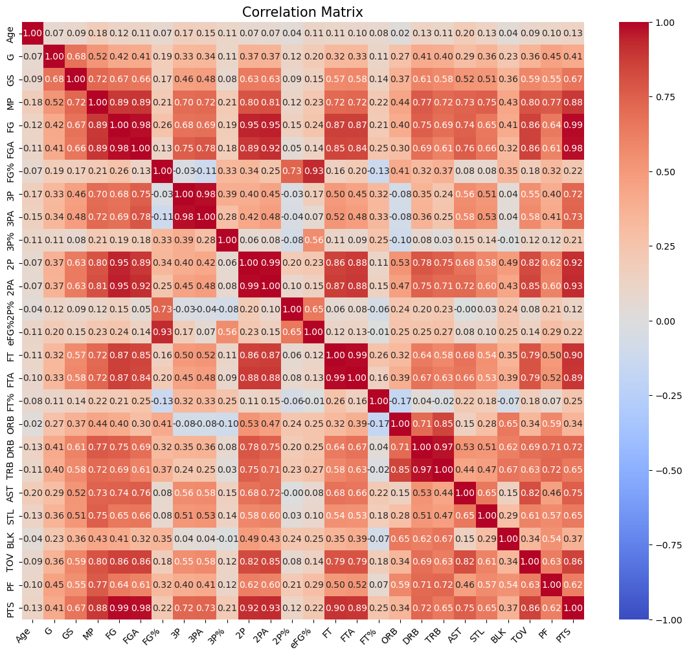
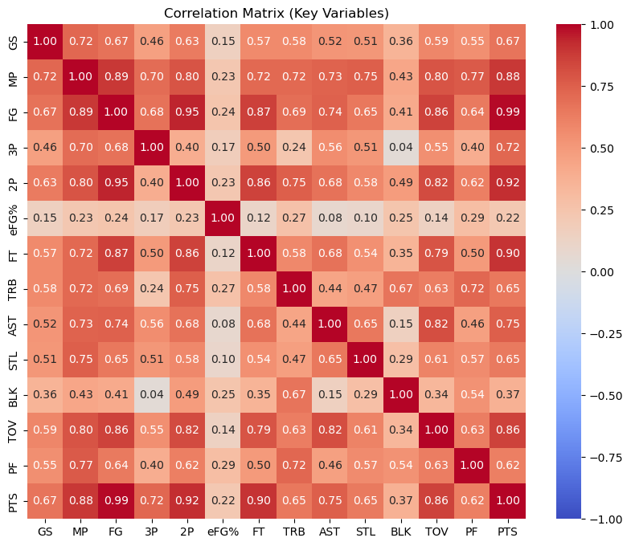
EDA
Subset of Relevant Variables
All-variables
Notes:
Jenny
Correlation matrices for all & subset of variables
positive correlations:
FGA & PTS; players who attempt and/or score more field goals also tend to score more points
AST & MP: players with more playing time tend to have more opportunities to assist
BLK & TRB (0.67); suggests that players who are good at blocking shots are also effective rebounders (this would be true of positions like centers)

Slide 9
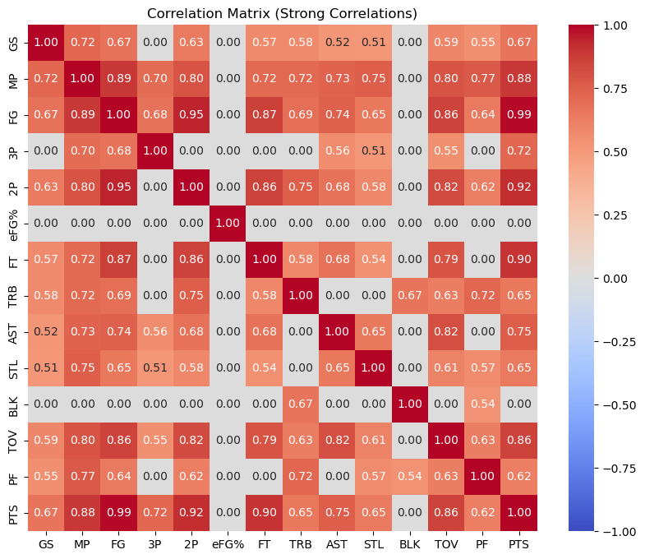
EDA
Subset of Relevant Variables
Minutes Played (MP):
Strongly correlated with PTS (0.88), TOV (0.80), AST (0.73), and PF (0.77)
More playing time lends itself to higher values in these areas
Points per Game (PTS):
Strongly correlated with FG (0.99), 2P (0.92), FT (0.90)
Effective shooters tend to have higher points per game
Notes:
Jenny
Correlation matrix for subset of variables (where absolute value of corr > 0.5)
minutes played (MP) is strongly correlated w/ various performance metrics such as points per game (0.88), turnovers (0.80), assists (0.73), & personal fouls (0.77); suggests that players with more playing time tend to have higher values in these areas
regarding shooting, there are strong correlations between points per game with field goals, two-pointers, & free throws; indicating that players who are effective at making these shots rightfully tend to have higher points per game

Slide 10
Wrangling for Model
Renaming:
Changed variable names from abbreviations to exact names
Selection:
For training purposes, only selected columns where correlation was higher than 40% with points scored
Notes:
Maru
The name of the variables were changed to enhance understanding while model training & testing.
Further, the input columns were dropped for , to reduce computation costs and increase model accuracy.

Slide 11
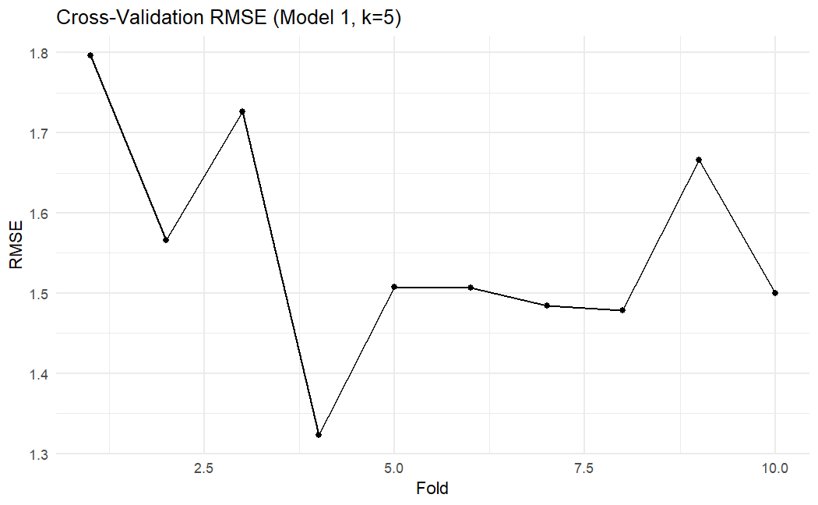
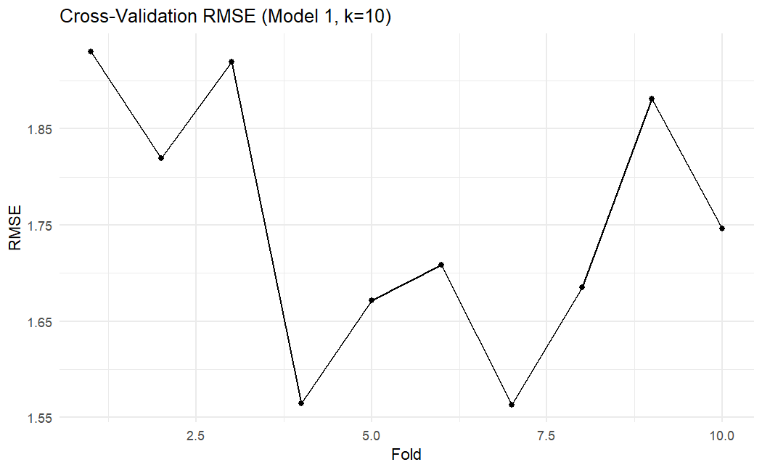
kNN Model 1
Model RMSE: 1.21 Cross-Validation Mean RMSE: 1.56
Cross-Validation SD: 0.14
Model RMSE: 1.50 Cross-Validation Mean RMSE: 1.75
Cross-Validation SD: 0.14
Notes:
Gayathree
Games started, minutes played, field goals per game, and free throws as predictors
This initial kNN model has a mean squared error (MSE) of 1.21; this seems reasonably low, especially in the context of predicting NBA players' points per game, where small prediction errors (around 1 point) are relatively acceptable.
The cross-validation results for the kNN model shows a mean RMSE of 1.555605, which is reasonable considering that an average prediction error of about 1.58 points per game is relatively small in the context of typical scoring ranges in the NBA.
The low standard deviation of the RMSE values (0.1383197) indicates that the model's performance in predicting player scoring is consistent across different folds of the data.
As plotted, the RMSE values indicate that the prediction errors fluctuate slightly across the different folds but remain relatively low overall. The lowest RMSE is seen in Fold 4; however, the higher RMSE in Folds 1 and 5 indicates some performance variability.
The cross-validation results for the kNN model show that it has a mean RMSE of 1.748932 with a low standard deviation of 0.1352917, meaning that on average, the model is only about 1.79 points off.
In comparison to the previous model with 5 neighbors, it is slightly less accurate, but has higher consistency in its performance. However, both models do a good job in predicting a player's points per game given the predictors of games started, minutes played per game, field goals per game, and free throws per game.
As plotted, the RMSE values are generally higher compared to the model with 5 neighbors. However as in the previous model, Fold 4 shows the lowest RMSE, however performance variability is more pronounced here, particularly with Fold 5 showing the highest RMSE (suggests that increasing the number of neighbors may lead to a slightly less accurate model).

Slide 12
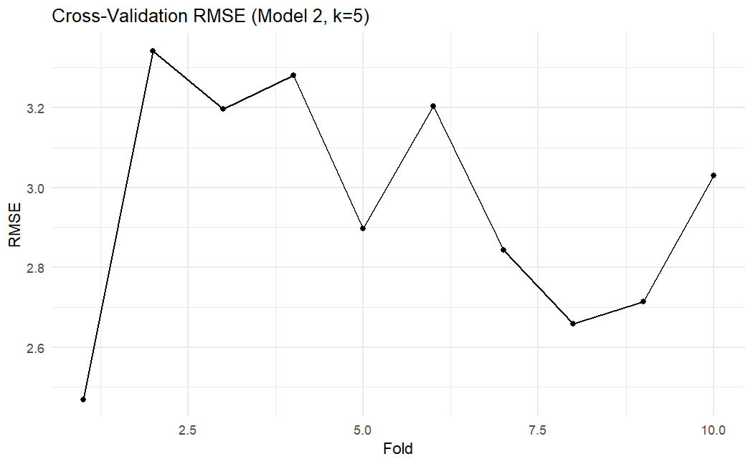
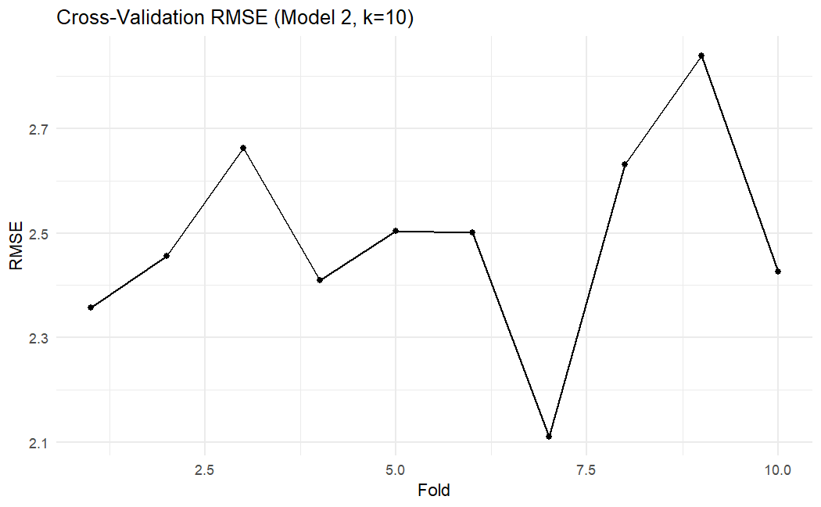
kNN Model 2
Model RMSE: 1.92 Cross-Validation Mean RMSE: 2.96
Cross-Validation SD: 0.29
Model RMSE: 2.17 Cross-Validation Mean RMSE: 2.49
Cross-Validation SD: 0.20
Notes:
Gayathree
Majority of predictors: position + age + games_played + games_started +
minutes_played_per_game + field_goals_per_game + free_throws_per_game +
total_rebounds_per_game + assists_per_game + steals_per_game + blocks_per_game +
turnovers_per_game
The initial RMSE value of 1.92 indicates that the model's predictive performance are relatively close to the actual points per game. While the mean RMSE from cross-validation is higher at 2.96, suggesting that while the model performs reasonably well on the training data, its predictions are less accurate when evaluated on unseen data subsets, especially when coupled with an increased average prediction error of about 2.96 points per game.
Compared to Model 1, which had a lower mean cross-validation RMSE, Model 2 shows higher prediction errors. This indicates that Model 1 might be more effective in predicting PTS with fewer predictors but better accuracy; Model 2, while using a broader set of predictors, does not necessarily translate into better performance, as seen by the higher RMSE values.
As plotted, the RMSE values indicate a higher level of prediction error compared to Model 1 with 5 neighbors. However, again the lowest RMSE is seen in Fold 4, while Fold 2 shows the highest RMSE. This performance suggests that including more predictors in Model 2 does not necessarily improve prediction accuracy and can lead to more inconsistent results.
The initial RMSE value is 2.17, with the mean RMSE from cross-validation being higher at 2.49 (and a standard deviation of 0.1961762). Both model seem to have a moderate level of accuracy.
As plotted, Model 2 using 5 neighbors improves prediction accuracy compared to using 10 neighbors, but it still does not outperform Model 1; Model 1 (k=5 Neighbors) remains the most effective model with the lowest and most consistent RMSE values.

Slide 13
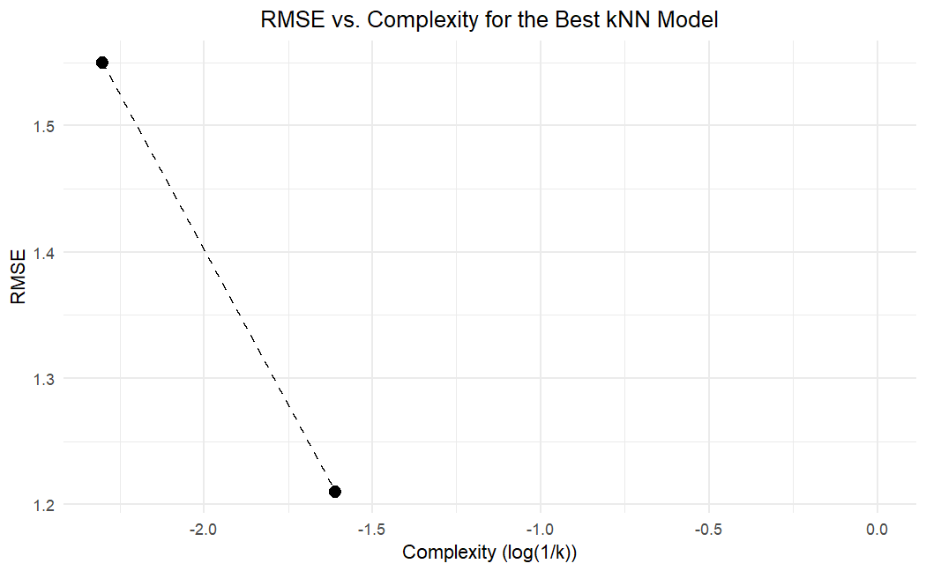
The Best Model
Notes:
Gayathree (skip)
K = 5 neighbors and 10 neighbors were tested in both models to check for effect on RMSE.
Did log(1/k) in x axis
The plot shows that lower k values (higher complexity) result in better model performance (lower RMSE).
This suggests that a more complex kNN model (with fewer neighbors) is better at capturing the underlying patterns in the data, resulting in lower prediction error.

Slide 14
k Nearest Neighbors
Results
Model 1 (k = 5 neighbors) is most effective model with lowest and most consistent RMSE values
Games started, minutes played, field goals per game, and free throws
Model 2 performs better with 5 neighbors than 10 neighbors, but still does not outperform Model 1
Both models are moderately accurate, but an error of 1.21 points per game translates to approx 88 goals in a season
Need a more complex model to better capture signal
Notes:
Gayathree
The initial RMSE value is 2.17, with the mean RMSE from cross-validation being higher at 2.50 (and a standard deviation of 0.14573). Both model seem to have a moderate level of accuracy.
Compared to Model 2 with 5 neighbors (RMSE of 2.96), the 10-neighbor model shows improved performance with a lower RMSE, indicating that using more neighbors helps improve the model's prediction accuracy. However, compared to the RMSE of Model 1 with 5 neighbors (1.58), Model 1 might be more effective in predicting a player's points per game with fewer predictors.
As plotted, Model 2 using 10 neighbors improves prediction accuracy compared to using 5 neighbors, but it still does not outperform Model 1; Model 1 (k=5 Neighbors) remains the most effective model with the lowest and most consistent RMSE values.

Slide 15
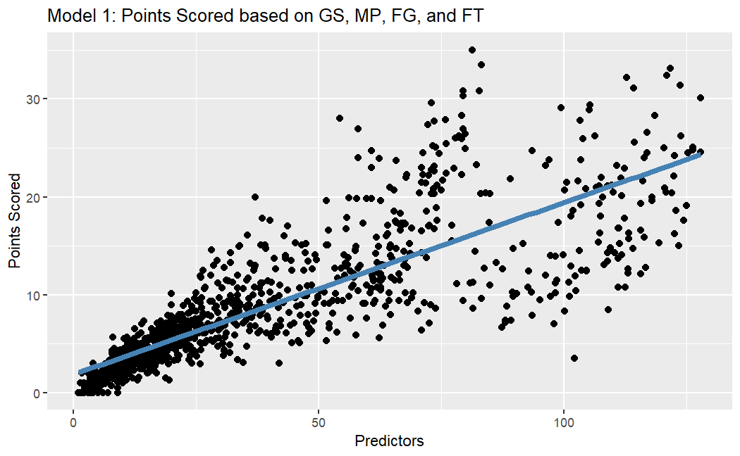
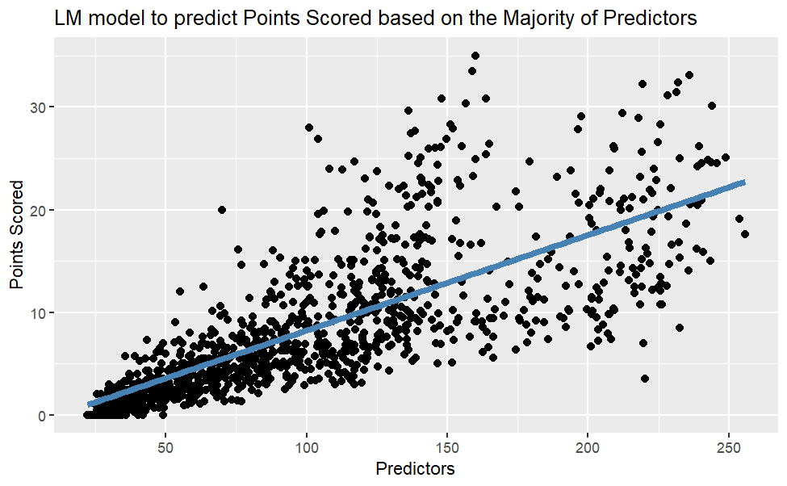
Linear Regression
Adj R-Squared: 0.99
CV RMSE: 0.62
Adj R-Squared: 0.99
CV RMSE: 0.49
Notes:
Gayathree
The linear regression model demonstrates excellent predictive power with a high adjusted R-squared value of .9922, with all predictors being statistically significant.
The fitted line on the scatterplot indicates a strong linear relationship, supporting the high R-squared value and showing that the model predicts PTS well based on the chosen predictors.
The cross validation results indicate that the linear regression model is highly accurate in predicting PTS for NBA players. With an RMSE of 0.6225894, the model's predictions are very close to the actual PTS values.
Both linear regression models demonstrate high performance in predicting PTS, with R-squared values of 0.9922 and low RMSE values from cross-validation (0.4909603 for Model 2); these results seem to show that the models can explain nearly all the variance in PTS and predict player performance with high accuracy. Lower RMSE for model 2 – better
However, this is achievement of high results is given a broader range of predictors, meaning that overfitting could be at play.
There is a possibility of heteroskedasticity- will have to address this in future iterations by taking the log of points scored

Slide 16
Linear Regression
Results
Both Linear models demonstrate high performance and accuracy
Broader range of predictors implies that overfitting could be at play
Due to the variability amongst the input variables, linear regression is probably not the best model – need more complex model to capture signal
Notes:
Gayathree
Both linear regression models demonstrate high performance in predicting PTS, with R-squared values of 0.9922 and low RMSE values from cross-validation (0.4909603 for Model 2); these results seem to show that the models can explain nearly all the variance in PTS and predict player performance with high accuracy.
However, this is achievement of high results is given a broader range of predictors, meaning that overfitting could be at play.
Heteroskedasticity – try stepwise regression, ridge regression, or lasso for variable selection or taking log of points scored

Slide 17
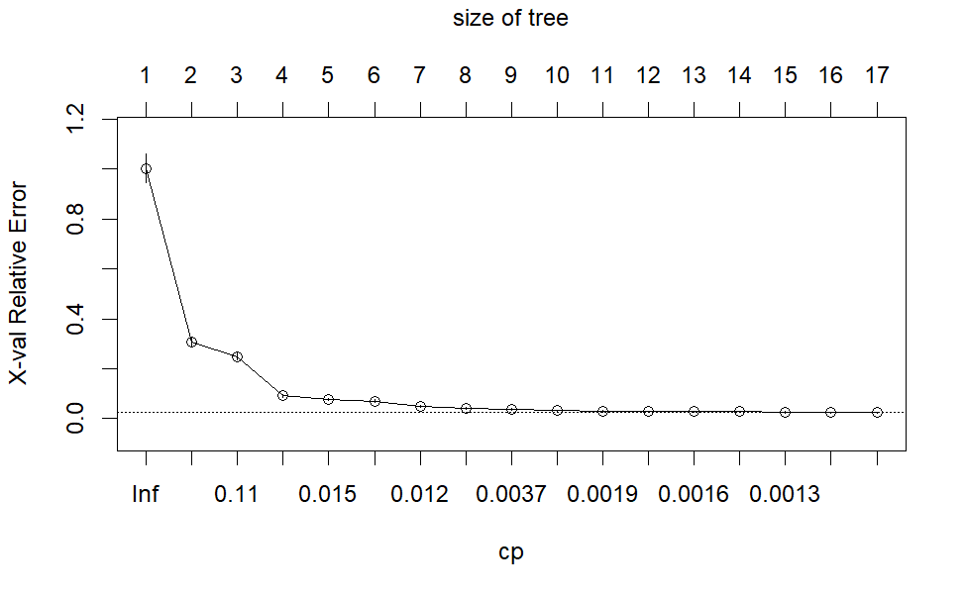
Random Forest
Results
A random forest model is created
Across a broad range of maximum nodes, input dimensions and number of trees, the model is trained and fine-tuned
Notes:
Ronak

Slide 18
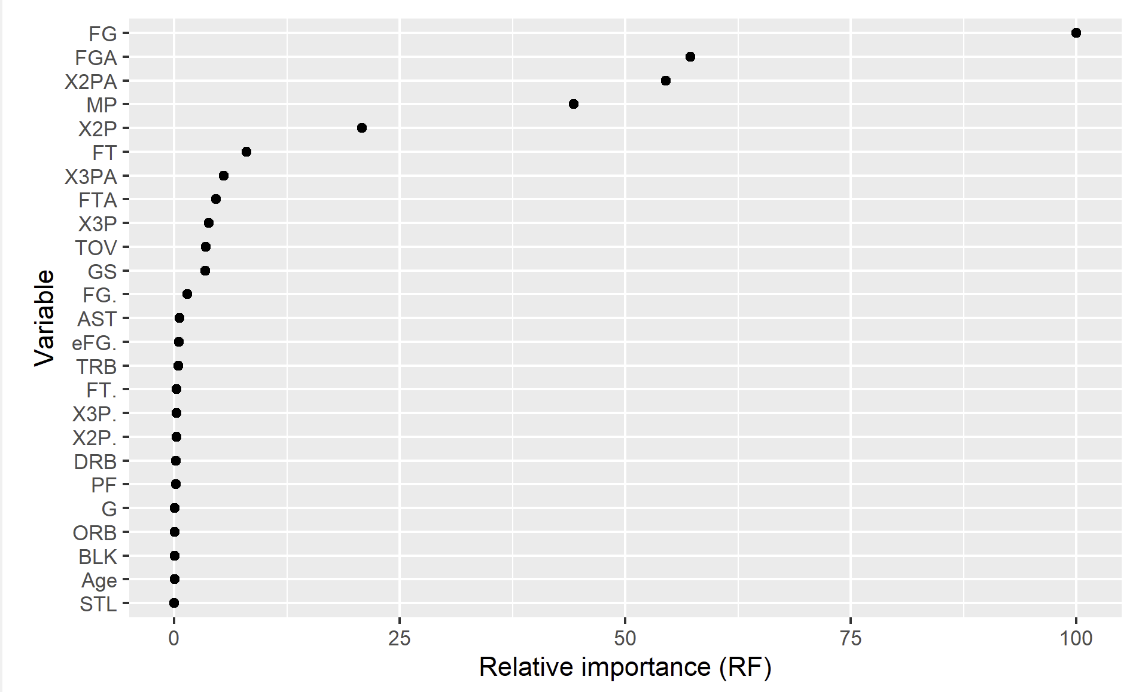
Random Forest
Notes:
Ronak
The plots highlight how the RMSE decreases as the number of predictors increases from three to ten, reaching its lowest points at mtry= 10 (its error bars is well below the dotted horizontal line, indicating the RMSE value is within one standard deviation of the best RMSE).
The random forest model demonstrates robust predictive performance. It seems that
increasing the number of trees in the forest accordingly improves the model's
accuracy, as indicated by decreasing RMSE values: 0.3858745 for 10 trees, 0.3115748 for 500
trees, and 0.3098001 for 1000 trees.
Yet, the out-of-bag (OOB) error plot reveals that while adding more trees initially
reduces the error significantly, the improvement stabilizes beyond 500 trees, indicating
diminishing returns from additional trees.

Slide 19

Trees (Boosting)
Results
Now a boosting model is created
Across a broad range of tree depth, shrinkage parameters and number of trees, the model is trained and fine-tuned
Notes:
Ronak
The boosting model demonstrates high performance, with an almost perfect fit on the training and validation data (RMSE of 0.03822) and a very low error on the test data (RMSE of 0.3043306). The close alignment of predicted and actual values in the plot further confirms its effectiveness, proving that the boosting model is a powerful tool for forecasting NBA player performance based on their comprehensive statistics.

Slide 20
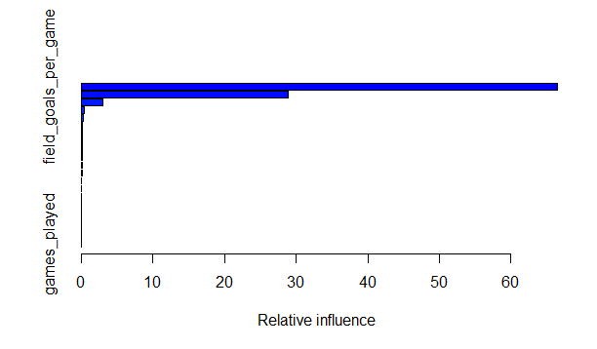
Trees (Boosting)
library(randomForest)
Notes:
Ronak
The plots show that increasing the number of iterations and shrinkage rates (to 50 and 0.1-0.2), while having moderately high tree depths (around size 10) when boosting tend to perform the best, achieving the lowest RMSE values. While the models' performance stabilizes with increased tree depth and iterations, beyond certain points, additional complexity holds diminishing returns while risking overfitting.

Slide 21
Results
The most important predictors were:
Field goals per game
Field goal attempts per game
The most important models were:
Boosting
The most important positions were:
Center
Power Forward
Notes:
Maru
Best predictors of highest points scored were field goals per game
RMSE of boosting was the best of all our models (with the lowest value)
Center and power forward positions have the highest field goal completion %
If your team wants to increase their points scored in a season, you should look to recruit those positions, with high FG & FGA scores per game
SPECIFICALLY IF YOU WANT TO SCORE MORE POINTS

Slide 22
Implications
Real life applications:
NBA Trading
Sports Betting
Coaching
Future scope:
Train on more data (at least a decade of statistics, more features)
Team-Player statistics for matching
Notes:
Maru
APPLICATIONS
Trading: View player stats and be able to determine how successful they will be next season, make decisions about trading players more easily
Sports betting: if a person wants to gamble on a player, they might want to look at stats a player has in a given season to predict their performance per game
Coaches: design training programs based on player weaknesses
FUTURE
More data is always good! By training on more seasons and more features, we might be able to better predict performance across seasons
Tailor to certain positions, analyze data about what players actually end up getting traded
Based on teams data, we can determine areas of weakness and therefore recommend a player based on player stats in order to maximize chances of winning their next season
Cost analysis, invest in the right players

Slide 23
Thank you!
Questions?

Slide 24
Works Cited
Datasets:
https://www.kaggle.com/datasets/bryanchungweather/nba-players-data-2022-2023
https://www.kaggle.com/datasets/bryanchungweather/nba-player-stats-dataset-for-the-2023-2024/data
Cover Image:
https://unsplash.com
Resources for Model Building:
https://jaredsmurray.github.io/sta380_msba/
An Introduction to Statistical Learning with Applications in R, Second Edition
ChatGPT

